Slide 1
Predicting Board Game Complexity
Q Leedham

Slide 2
Problem Statement
With platforms like Kickstarter, anyone with an idea can easily make and produce a board game on their own. But while it's easy to produce a game, it's hard to know how how complicated the game will be for players. There is a complexity, or weight, rating on Board Game Geek, though it relies on community voting. Is it possible to predict that rating knowing what a creator would know at the start of their project?
Is there a correlation between the mechanics and features of a board game and the game's complexity rating, or weight, on Board Game Geek?

Slide 3

Data Sources
Board Game Geek
Kaggle

Slide 4


EDA
Not much correlation
Had to decide between regression and classification

Slide 5
Mechanics & Categories
103 total mechanics
82 total categories
None are highly correlated with weight

Slide 6
Voting Classifier Model
66% accurate
TPR ”light”: 72%
TPR “medium light”: 73%
TPR “medium”: 55%
TPR “medium heavy”: 21%
TPR “heavy”: 0%

Slide 7
Logistic Regression: Light Complexity
Mature/Adult is the biggest positive coefficient
Napoleonic and Civilization the biggest negative coefficients

Slide 8
Medium Light
Murder/Mystery biggest positive coefficient
Alliances and Mature/Adult biggest negative coefficients

Slide 9
Medium Complexity
Crayon Rail System is biggest positive coefficient
Party Game and Memory are biggest negative coefficients

Slide 10
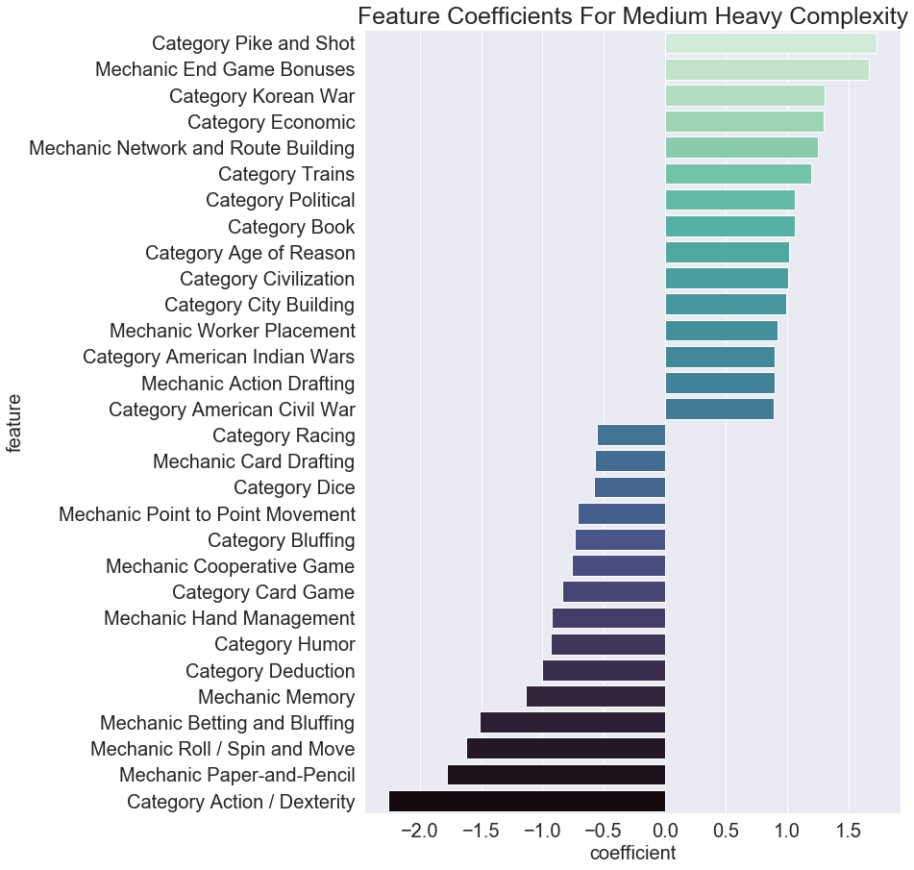
Medium Heavy Complexity
Pike and Shot and End Game Bonuses are biggest positive coefficients
Action/Dexterity and Paper-and-Pencil are biggest negative coefficients

Slide 11
Heavy Complexity
Expansions and Wargames are the biggest positive coefficients
Minimum Number of Players Squared and Cooperative Games are biggest negative coefficients

Slide 12
Production Model
Live demo of deployed model here

Slide 13
Recommendations
Use Natural Language Processing on descriptions
More game information (number of pieces, size of rulebook, etc.)
Image recognition on game boards

